Slide 1
Parenting Behaviors and Skill Building
Fathers and Sons Program
© 2022 The Regents of the University of Michigan
Notes:
Facilitator Script
(Read the text in the boxes as you go through the handout)
This handout discusses different parenting behaviors and ways to building a strong father-son relationship.

Slide 2
Tips for Fathers
Be there: Children want and need your presence, from infancy onward.
Listen: Being there means more than being present physically.
Work together on behalf of your child, even if you're not living together.
- Learn to disagree appropriately with your son(s) mother.
- Disagreement is a normal part of parenthood. It is how you resolve those differences that matters.
© 2022 The Regents of the University of Michigan
Notes:
First let’s discuss some tips for Fathers.
One of the key aspects of building a relationship is being present in your son’s life—that means spending time together and supporting your son in his different activities. Not only is it important to be present physically, but you should also be there mentally and emotionally. By listening to your son you are able to learn more about what is going on in his life and how he is feeling.
The ability to work with your son’s mother can also impact parenting. Although you may not live together, both parents should work together to do what’s best for the child—that may mean that sometimes you disagree. Having disagreements is not bad, it’s about how you work together to resolve the differences that matters. By working together you also model positive behavior for your son.

Slide 3
Tips for Fathers
Get to know and be known to the people in your child's world.
Play with your children.
- Teachers, caregivers, and doctors are important people.
- Get to know and be known to your children's friends and their parents.
- If you have concerns about who your child is hanging out with, be sure to discuss this with your child.
- One of the best ways to learn about and develop a lasting connection with your children is to enter their world by playing with them.
© 2022 The Regents of the University of Michigan
Notes:
Another tip is to get to know and be known to the people in your child’s world. You may begin to do this by attending parent-teacher conferences or other school events, going to their doctors appointments, and getting to know your children’s friends and their parents. If you ever have concerns about who your child is hanging out with you should take the time to discuss that with your child.
Playing with your children also helps you to learn more about them and develop a connection with them. Playing could include sports, board games, video games, or any other types of activities your child may be interest in.

Slide 4
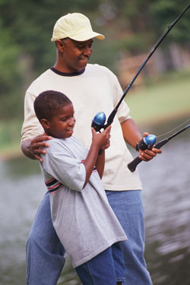
Tips for Fathers
Teach by example.
Discipline with love.
Keep your sense of humor.
- Children follow what you do more than what you say.
- To discipline means to guide or lead out the best in your child, and that is best done with love.
© 2022 The Regents of the University of Michigan
Notes:
One of the most important—and sometimes one of the hardest—things to do is to lead by example. You are one of your child’s first role models and they often model their behavior after what you do rather than what you say.
Disciplining with love also helps to shape the parent-child relationship. Discipline is used to guide or lead out the best in your child and disciplining with love helps show your child that you care. Examples of disciplining with love might include hugging your child after discipline or speaking firmly, but kindly.
Finally, parenting can be hard, but keeping your sense of humor allows you to stay positive.

Slide 5
Communication
Break the ice:
Awareness:
Ask questions like, “Is this a good time to talk?”
Plan activities for you and your son together
Pay attention to teachable moments
Listen effectively
Ask specific questions and avoid questions that require a yes or no answer
© 2022 The Regents of the University of Michigan
Notes:
As we know, communication plays a big role in building the father-son relationship.
When it seems hard to communicate, you can start by asking questions like, “Is this a good time to talk?” or planning activities for you and your son in order to break the ice.
Maintaining awareness can also enhance communication. You can work to build awareness by paying attention to teachable moments, listening effectively when your son talks, and asking specific open-ended questions rather than questions that allow your son to respond using “yes” or “no.”

Slide 6
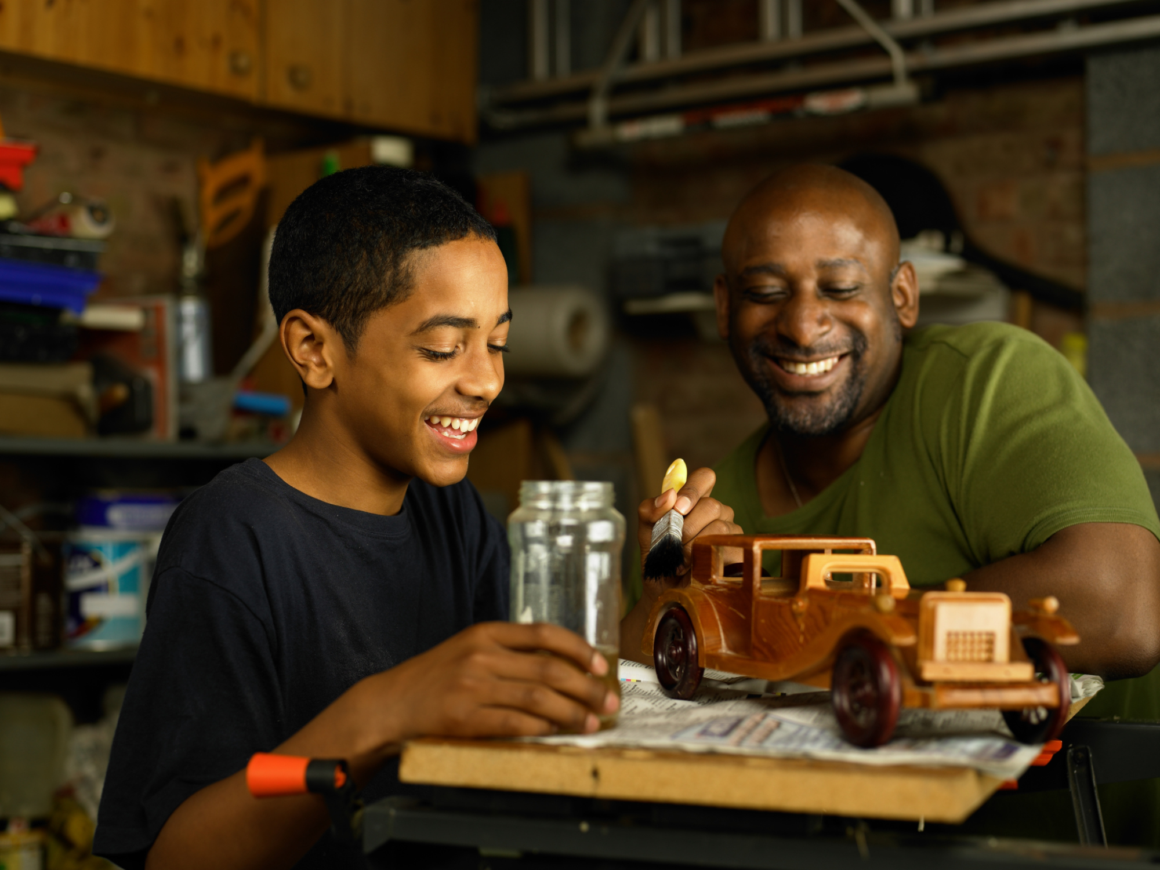
Communication
Make a connection:
Get involved in your child’s school and/or social life
Take advantage of talking during down time
Look at baby pictures together
Work on a project together like a hobby, building something, writing, drawing, etc.
© 2022 The Regents of the University of Michigan
Notes:
Communication can also help you to make a connection with your child.
In order to make a connection try getting involved in your child’s school and/or social life, talking during down time, looking at baby pictures together, or working on a project together like a hobby, building something, writing, or drawing.

Slide 7
Nobody said fatherhood would be easy…
If you can survive fatherhood, you can survive anything!
© 2022 The Regents of the University of Michigan
Notes:
It’s true that nobody said fatherhood would be easy, but if you can survive fatherhood, you can survive anything!

Slide 8
REFERENCES
Bright Horizons Family Solutions. (n.d.) How to Be a Good Father: Tips and Advice for Dads. Retrieved from: http://www.brighthorizons.com/family-resources/e-family-news/2012-the-art-of-being-a-father/
Kutner, L. (2004). Let’s Connect: A Guide to Communication-Friendly Parenting. Retrieved from: http://www.friscoisd.org/ly/news/tips_commfriendlyparent.pdf
© 2022 The Regents of the University of Michigan

Slide 9
CREDITS
Special thanks to all the people who made and released these awesome resources for free:
Presentation template by SlidesCarnival
Photographs by Unsplash
© 2022 The Regents of the University of Michigan

