Slide 1
Evolution of Technology Trivia
Fathers and Sons Program
© 2022 The Regents of the University of Michigan
Notes:
Facilitator Script
(Read the text in the boxes as you go through the PowerPoint slides)
In order to further our discussion about the evoluation of technology we are going to play a fun game to show how technology has changed over time.

Slide 2
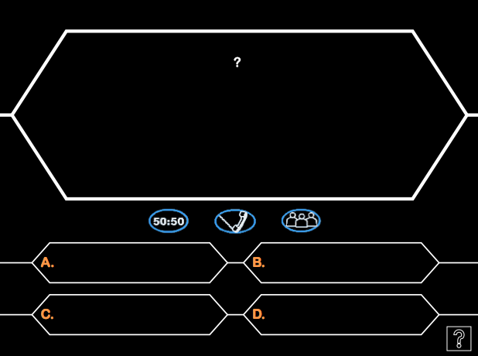
When was the first laptop or portable computer released?
2005
1975
1980
1995
© 2022 The Regents of the University of Michigan

Slide 3
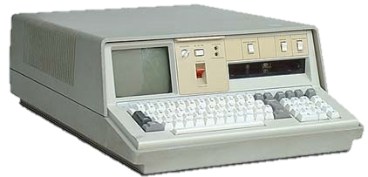
When was the first laptop or portable computer released?
2005
1975
1980
1995
© 2022 The Regents of the University of Michigan

Slide 4
How much did the computer weigh?
5 pounds
30 pounds
55 pounds
10 pounds
© 2022 The Regents of the University of Michigan

Slide 5
How much did the computer weigh?
5 pounds
30 pounds
55 pounds
10 pounds
© 2022 The Regents of the University of Michigan

Slide 6
What was the name of the first video game console?
XBOX
Atari
Nintendo DS
Brown Box
© 2022 The Regents of the University of Michigan

Slide 7
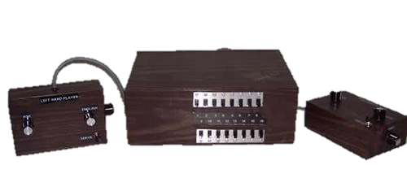
What was the name of the first video game console?
XBOX
Atari
Nintendo DS
Brown Box
© 2022 The Regents of the University of Michigan

Slide 8
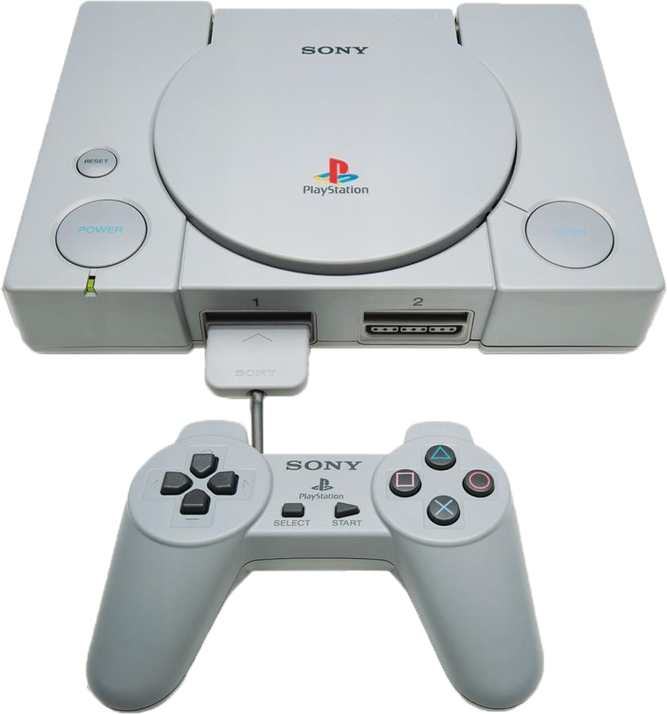
What year
was the first Playstation released?
2001
1999
1995
2003
© 2022 The Regents of the University of Michigan

Slide 9
What year
was the first Playstation released?
2001
1999
1995
2003
© 2022 The Regents of the University of Michigan

Slide 10
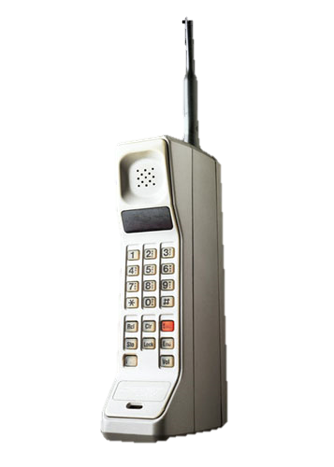
What year was the first handheld cell phone produced?
1973
1950
2004
1990
© 2022 The Regents of the University of Michigan

Slide 11
What year was the first handheld cell phone produced?
1973
1950
2004
1990
© 2022 The Regents of the University of Michigan

Slide 12
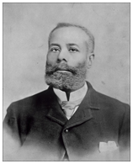
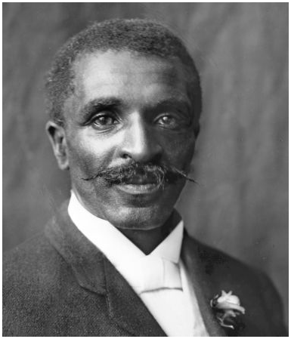
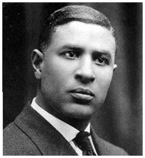
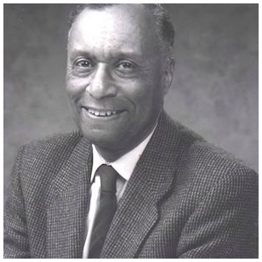
What black inventor and Aerospace engineer invented technology that is now used in cell phones?
Elijah McCoy
George Washington Carver
Garrett A. Morgan
Henry Thomas Sampson
© 2022 The Regents of the University of Michigan
Notes:
C

Slide 13
What black inventor and Aerospace engineer invented technology that is now used in cell phones?
Elijah McCoy
George Washington Carver
Garrett A. Morgan
Henry Thomas Sampson
© 2022 The Regents of the University of Michigan
Notes:
C

Slide 14
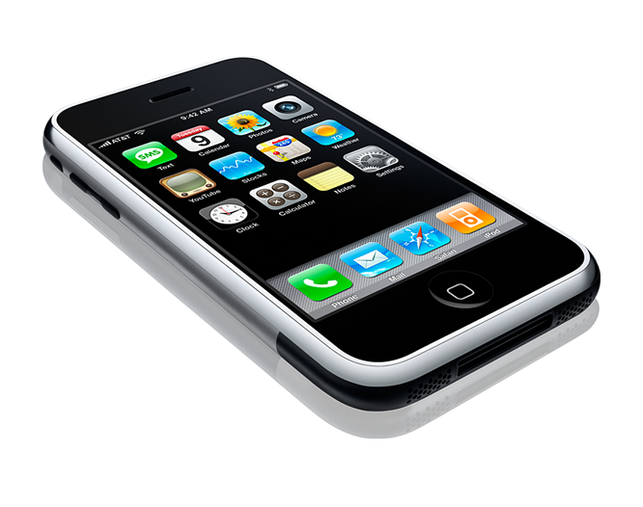
What year was the first iPhone released?
2010
2007
2000
2012
© 2022 The Regents of the University of Michigan

Slide 15
What year was the first iPhone released?
2010
2007
2000
2012
© 2022 The Regents of the University of Michigan

Slide 16
What percentage of teens feel they are addicted to their cell phones?
25%
50%
99%
5%
© 2022 The Regents of the University of Michigan

Slide 17
What percentage of teens feel they are addicted to their cell phones?
25%
50%
99%
5%
© 2022 The Regents of the University of Michigan

Slide 18
What percentage of parents feel they are addicted to their cell phones?
27%
75%
44%
90%
© 2022 The Regents of the University of Michigan

Slide 19
What percentage of parents feel they are addicted to their cell phones?
27%
75%
44%
90%
© 2022 The Regents of the University of Michigan

Slide 20
What percentage of teens feel the need to immediately respond to texts, social networking messages, and other notifications?
72%
82%
22%
52%
© 2022 The Regents of the University of Michigan

Slide 21
What percentage of teens feel the need to immediately respond to texts, social networking messages, and other notifications?
72%
82%
22%
52%
© 2022 The Regents of the University of Michigan

Slide 22
References
http://www.computerhope.com/issues/ch000984.htm
© 2022 The Regents of the University of Michigan

