Slide 1
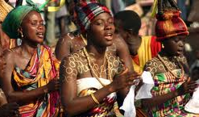
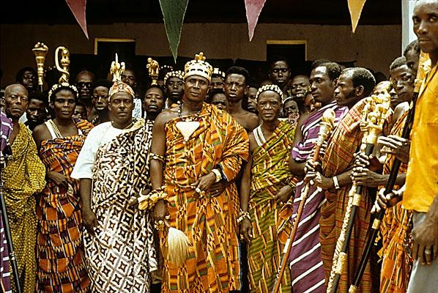
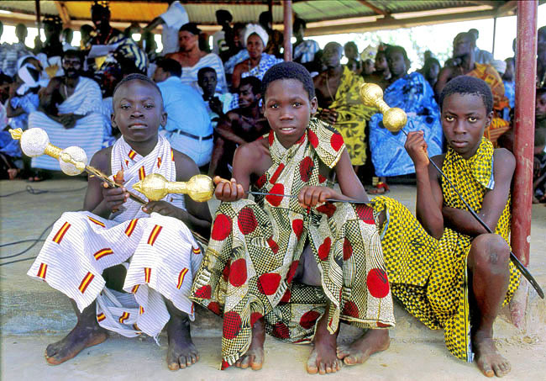
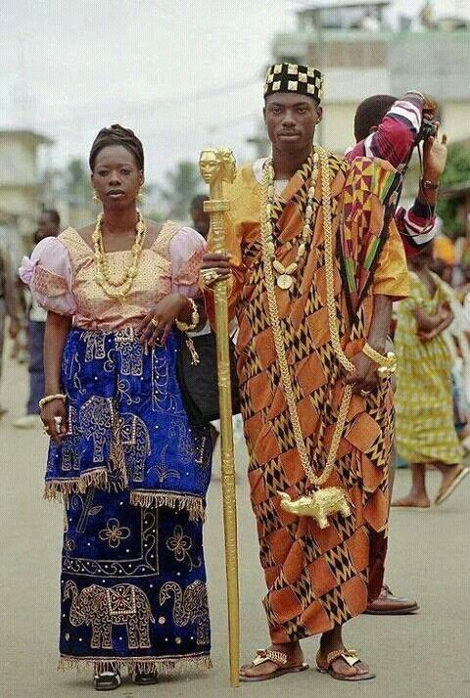
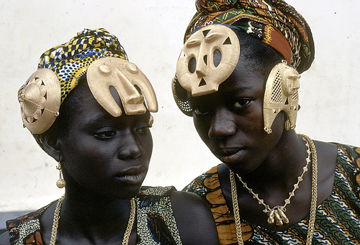
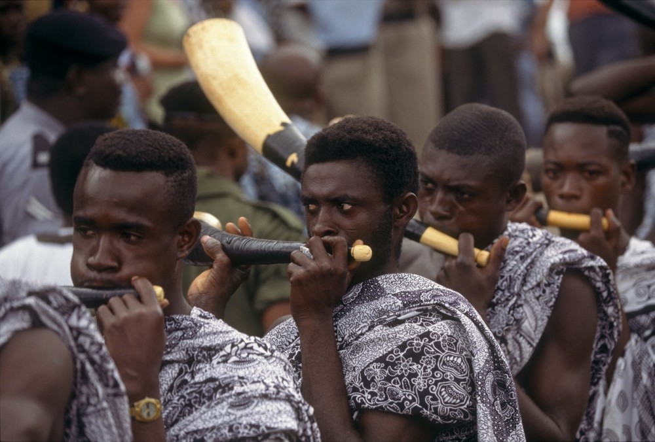
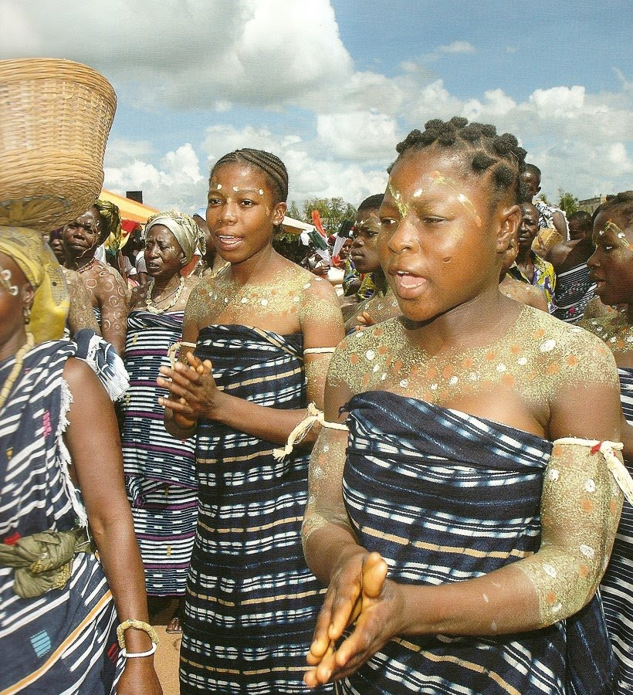
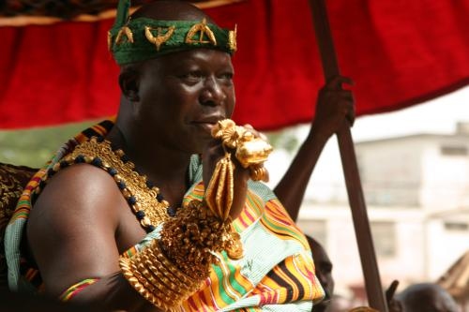
History of Adinkra Symbols Fathers and Sons Program
© 2022 The Regents of the University of Michigan
Notes:
Facilitator Script
(Read the text in the boxes as you go through the PowerPoint slides)
In today’s session you will learn about one group of people from Africa: the Akan people of Ghana and one of their cultural practices of making Adinkra cloth. We are going to explore the meaning of some of the Adinkra symbols and show you how the Ghanaian people used them in making Adinkra cloth. Using paints and construction paper, you will have the opportunity to make your very own Adinkra cloth.
Each family will create their own special cloth to represent what they mean to each other. We are going to take most of today’s session to do this, so be prepared to have some fun!

Slide 2
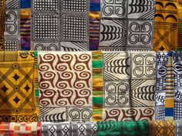
Adinkra Cloth
Adinkra is one of the hand-printed and hand-embroidered cloths in Africa
Its origin is traced to the Asante people of Ghana
© 2022 The Regents of the University of Michigan
Notes:
Adinkra is one of the hand-printed and hand-embroidered cloths in Africa. Its origin is traced to the Asante (ASH-AHNTI) people of Ghana.¹
The origin of the Adinkra cloth is also traced to the Gyaman (GUY-AY-MAHN) people of the Ivory Coast.¹ However, its creation and use have come to be more associated with the Asante (ASH-AHNTI) people than any other group of people.¹
This picture represents an example of Adinkra cloth.

Slide 3
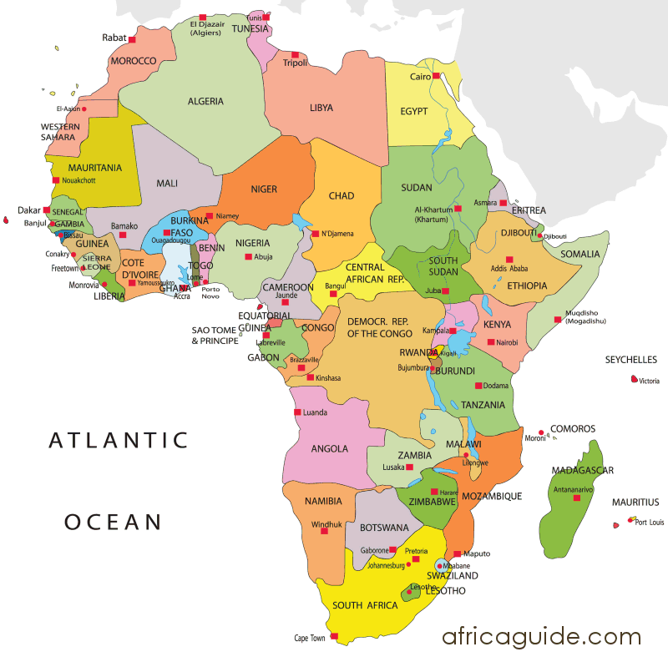
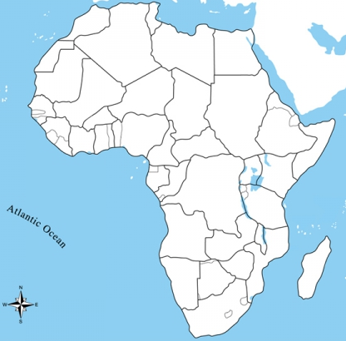
Continent of Africa
Looking at your map of Africa, locate Ghana and the Ivory Coast.
What part of Africa are these two countries in?
Hint: Not East!
© 2022 The Regents of the University of Michigan
Notes:
Before we go any further let’s get a picture in our minds of where Ghana and the Ivory Coast are located. I am passing out a copy of a map of Africa. On the map tell me what part of Africa these two countries are located in.
Answer: WEST AFRICA
We can also understand that because these two countries are located in the same area, that their cultures are VERY SIMILAR.
Cultures are things that make people unique within a certain group. For instance, HIP HOP is a culture specific to particular African American generations. Policemen and women are considered a part of the same culture, so are people in the church.
Let’s talk about some things that make up culture. Can anyone tell me what they think makes up a culture?
Answer: Things such as clothing, music, and food make up a culture. But one of the most important things that is a port of culture is LANGUAGE. It is how people communicate with each other. Language allows me to speak to you and allows you to understand what I trying to say to you.
People from both of these countries, for example, speak to each other in a unique way–through symbols! They also share a common language such as French and Twi.
So what we will learn today is another unique way the people in these West African countries communicate, by using ADINKRA (AH-DINK-KRAH) symbols.

Slide 4
Africa
Does anyone know any other countries in Africa?
© 2022 The Regents of the University of Michigan
Notes:
Does anyone know any other countries in Africa?

Slide 5
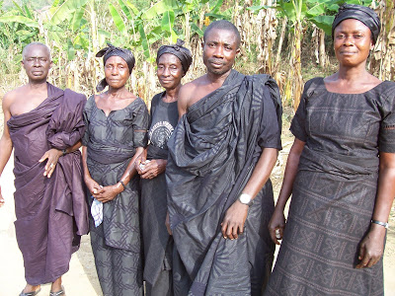
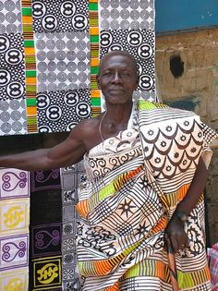
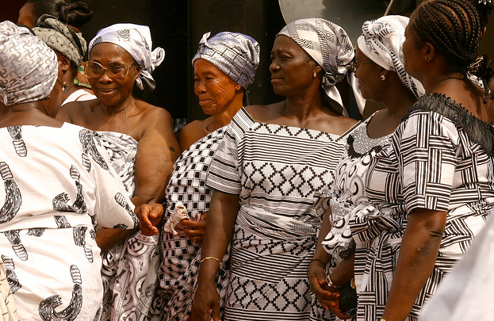
Many Uses of Adinkra
In Clothing:
Weddings
Naming Ceremonies
Initiation Rites
© 2022 The Regents of the University of Michigan
Notes:
Around the 19th century, the Asante people created this unique art of Adinkra printing.¹
In those days, Adinkra cloths were made and used exclusively by royalty and spiritual leaders for very important sacred ceremonies and rituals.¹
Today, Adinkra cloths are used for a wide range of social activities. In addition to its sacred usage, it is also used to make clothing for special occasions such as weddings, naming ceremonies, and initiation rites.¹

Slide 6
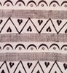
Love and Affection
MAH-KO-MAH MOO TOH-FAY
To communicate without words using symbols in cloth
Symbol of LOVE and AFFECTION
From the expression: M’akoma mu tofe
Literal translation:
My sweetheart
© 2022 The Regents of the University of Michigan
Notes:
The symbol printed onto fabrics may convey different kinds of messages. Colors, shapes of symbols, and orientation of symbols on the fabric convey different important messages.
For instance the combination of Adinkra symbols here symbolizes LOVE and AFFECTION.² So this may be something you would give to someone you want to express love and affection to (like your family).
Remember, this is a Ghanaian language, but all you need to focus on is the LITERAL translation of the word.

Slide 7
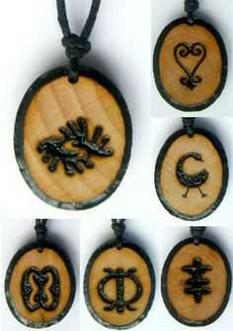
African Art
Jewelry with Adinkra symbols
© 2022 The Regents of the University of Michigan
Notes:
Designers use Adinkra symbols to create a wide range of things like jewelry, book covers, and clothing.² For example, we have used Adinkra symbols to name two Father-Son groups and made t-shirts from those symbols.
Another thing that makes cultures unique is the ART they create. Each symbols has it’s own meaning.
As a result of learning about some of the Adinkra symbols and their meanings, you will choose a symbol and design a t-shirt for your father-son group as well.

Slide 8
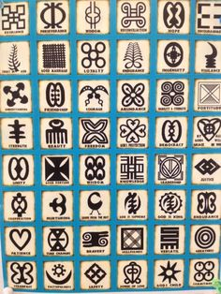
Adinkra Symbolism
© 2022 The Regents of the University of Michigan
Notes:
In this section we are going to talk about the symbolism in this culture.

Slide 9
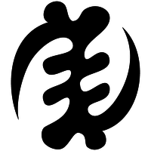
Gye Nyame
(gee-NAH-may)
Symbol of the OMNIPOTENCE OF GOD
Proverb: “God is a Great and All-Knowing Being. You are great as a people because His Spirit shines through YOU.”
© 2022 The Regents of the University of Michigan
Notes:
This symbol is one representation of GOD in the AKAN (AH-KAHN) culture. It represents what is GREAT!

Slide 10
Sankofa
(san-KOH-fah)
Sankofa - Go back to get it
Symbol of the wisdom in LEARNING FROM THE PAST in building for the future
Proverb: “It is not taboo to go back and retrieve what you forget.”
© 2022 The Regents of the University of Michigan
Notes:
SAN-KOH-FAH represents learning. One should learn about their past to understand the future.
This symbol is used widely to represent African American people in this country “looking back” to their past to understand who they are today.
The great contributions that Africans have made to this world are limitless!

Slide 11
Odo Nyera Fie Kwan
(oh-doh-nee-AIR-rah fee qwahn)
Odo Nyera Fie Kwan - love does not get lost on its way home
Symbol of LOVE, DEVOTION, and FAITHFULNESS
Proverb: “Love lights its own path; it never gets lost on its way home.”
© 2022 The Regents of the University of Michigan
Notes:
This symbol is used to convey the strength involved in growing and maturing in this world.
We have to understand that our experiences are unique ones and that if you “train a child in the way that he should go…he will not depart from it.”²

Slide 12
Dweni Ni Mmen
(do-wen-nee-NEE-men)
Dweni Ni Mmen - love does not get lost on its way home
Symbol of STRENGTH (of mind, body, and soul) and HUMILITY
Proverb: “The ram may bully, not with its horns, but with his heart.”
© 2022 The Regents of the University of Michigan
Notes:
This symbol is most appropriate to convey messages of strength in a person.²
It shows that we all have something to learn and that love is sometimes called “tough love.” But we must honor the lessons we learn from all of our elders, children and parents alike.

Slide 13
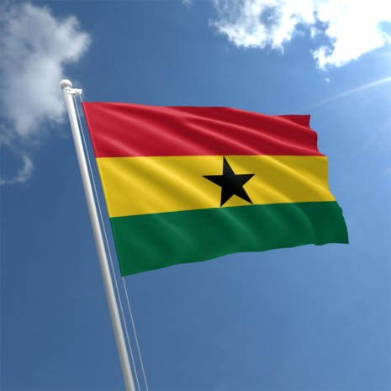
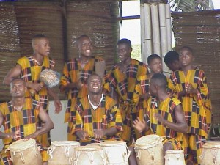
Be Proud of You!
Think about your strengths
Recognize your contributions to society
Learn about your culture
© 2022 The Regents of the University of Michigan
Notes:
The reason we can value Adinkra symbolism in our culture is because our ancestors are from Africa. Ancestors are people who lived many, many years before us. Our ancestors represent a part of our family that is no longer with us. They represent where we originally came from. As a result of our African ancestry, we can add some of that rich African history and meaning to our lives, even today.
Just as the American Flag represents the United States as a country and its people, Adinkra is one way to represent what is African, particularly among the Akan people of Ghana and the Ivory Coast.
So be proud and know that you are of African ancestry and that part of your culture is rooted in the rich soil of Africa. Remember, the Akan people represent only one culture in Africa. There are thousands more cultures from Africa to learn about. We’ve only just begun to appreciate our greatness!
(END OF PRESENTATION)

Slide 14
References
St. Lawrence University. (n.d.) Adinkra – Cultural Symbols of the Asante people. Retrieved from http://www.stlawu.edu/gallery/education/f/09textiles/adinkra_symbols.pdf
Well-Tempered Web Design. (2007). West African Wisdom: Adinkra Symbols & Meanings. Retrieved from http://www.adinkra.org/htmls/adinkra_index.htm
© 2022 The Regents of the University of Michigan

Slide 15
Image Citations
http://4.bp.blogspot.com/-JvC8EM2NaBg/UXQr7V1LeBI/AAAAAAAAARI/HlSws0k7rFU/s1600/Akan+Women.jpg
http://classconnection.s3.amazonaws.com/1711/flashcards/273361/jpg/hjd0518r.jpg
http://3.bp.blogspot.com/-2dFXSFHSRy4/UKu93MKMKiI/AAAAAAAADv8/Nlmsnea58fY/s1600/Ghana_sword_bearers_Blog.jpg
https://s-media-cache-ak0.pinimg.com/564x/82/3a/39/823a396d0ca7fb2a4a43d48e26f4d5fd.jpg
https://c2.staticflickr.com/2/1017/1152550366_ebc99c19e2.jpg
https://3.bp.blogspot.com/-thPRw9Z3W-8/VrYjaDyI1II/AAAAAAAACL8/C-cVeKmDHGY/s640/Akan%2Bpeople.jpg
https://africa.uima.uiowa.edu/assets/Frank-Fournier/_resampled/FitWzEwMDAsMTAwMF0/FRF019.jpg
http://buzzghana.com/wp-content/uploads/2013/10/Akan-people.jpg
hhttps://s-media-cache-ak0.pinimg.com/236x/4c/7b/b3/4c7bb34faa9d4429767660e11099110e.jpg
http://www.montessorieducationalsupplies.co.za/media/product/unlabeled-africa-control-map-551bf4d6b0343.jpg
https://www.africaguide.com/image/maps/africa_map.png
http://66.media.tumblr.com/tumblr_lpb1xy5xoI1qj9n1no1_1280.png
http://1.bp.blogspot.com/_siPTpByzr18/SAM0tUkKWKI/AAAAAAAACAg/rMIKYlaxKhc/s400/Akink++Funeral+Cloths.JPG
https://s-media-cache-ak0.pinimg.com/236x/3d/7f/6e/3d7f6e59ec3892babd0dbcfabcdaafa3.jpg
http://1.bp.blogspot.com/_NJj1gS1wEqs/Sh1E_GYVfeI/AAAAAAAABRE/AGyKCilpayM/s400/toffee.jpg
https://s-media-cache-ak0.pinimg.com/236x/9c/a4/97/9ca49753bda5904069e4b7145497235e.jpg
https://s-media-cache-ak0.pinimg.com/236x/42/a5/02/42a5024f479151168d1d5e1406f8ef76.jpg
http://www.adinkrasymbols.org/adinkra/gye-nyame-medium.png
http://www.zettaelliott.com/wordpress/wp-content/uploads/2008/12/sankofa.png
https://s-media-cache-ak0.pinimg.com/236x/c3/e7/6b/c3e76bfad4bf68369c51ef5fe08914ee.jpg
http://www.the-symbols.net/images/african-symbols/dwennimmen.jpg
http://media.gettyimages.com/videos/barack-obama-legacy-black-man-holds-world-in-hands-video-id129805283?s=640x640
https://www.theflagshop.co.uk/media/catalog/product/cache/1/thumbnail/465x/17f82f742ffe127f42dca9de82fb58b1/g/h/ghana-flag-std.jpg
https://www.theflagshop.co.uk/media/catalog/product/cache/1/thumbnail/465x/17f82f742ffe127f42dca9de82fb58b1/i/v/ivory-coast-flag-std.jpg
http://www.drumafrica.co.uk/wp-content/uploads/2011/02/ghana-culture-group-300x225.jpg
© 2022 The Regents of the University of Michigan

Slide 16
Credits
Special thanks to all the people who made and released these awesome resources for free:
Presentation template by SlidesCarnival
Photographs by Unsplash
© 2022 The Regents of the University of Michigan

