Slide 1
Social Media & Internet Safety
Fathers and sons Program
© 2022 The Regents of the University of Michigan
Notes:
Facilitator Script
(Read the text in the boxes as you go through the PowerPoint slides)
Today’s topic is one that you all may know a lot about - social media! We are also going to talk about how to be safe when using the internet and different forms of social media.

Slide 2
What are some popular social media outlets?
© 2022 The Regents of the University of Michigan
Notes:
To begin the presentation, let’s talk about some of the social media platforms. What are some popular social media outlets?
(WAIT FOR ANSWERS)
You all named some great examples. Now we are going to go through different forms of social media. Let’s begin with Facebook.

Slide 3
Facebook
The world’s largest social networking site
Allows you to connect and share with family and friends online
© 2022 The Regents of the University of Michigan
Notes:
Facebook is one of the most popular social media sites today. Facebook users can send messages, post status updates, share photos, videos, and links. The site also allows you to make groups as well as create events and invite guests.
“Unlike email or instant messaging, the things you share on Facebook are more public, which means they’ll usually be seen by many other people.” ¹

Slide 4
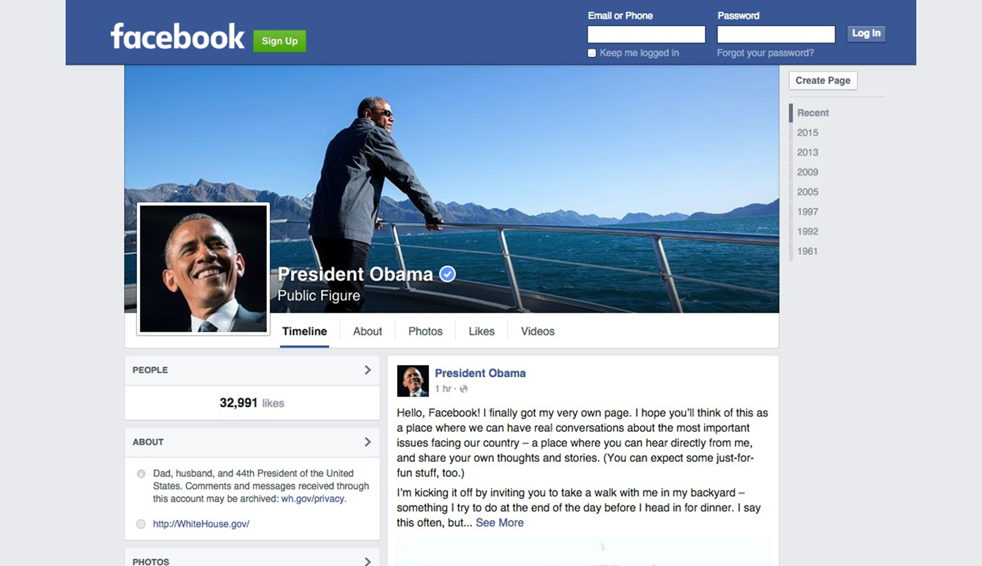
© 2022 The Regents of the University of Michigan
Notes:
Here is an example of President Obama’s Facebook profile. On his profile you can see his posts, click on his photos and videos, and learn more about him.

Slide 5
Twitter
140-character tweets/messages
Ability to connect with friends, celebrities, musicians, actors, etc.
Inclusion of photos and videos in tweets
© 2022 The Regents of the University of Michigan
Notes:
A couple of years after Facebook was founded, Twitter emerged as a popular social media site. You can use Twitter to find out what’s happening in the world right now—whether it’s related to music, sports, politics, news, or everyday moments.”²
On Twitter you are only allowed to post messages, also known as tweets, that are up to 140 characters long. Twitter is also know for the use of hashtags such as #BlackLivesMatter or #PrayforParis.

Slide 6
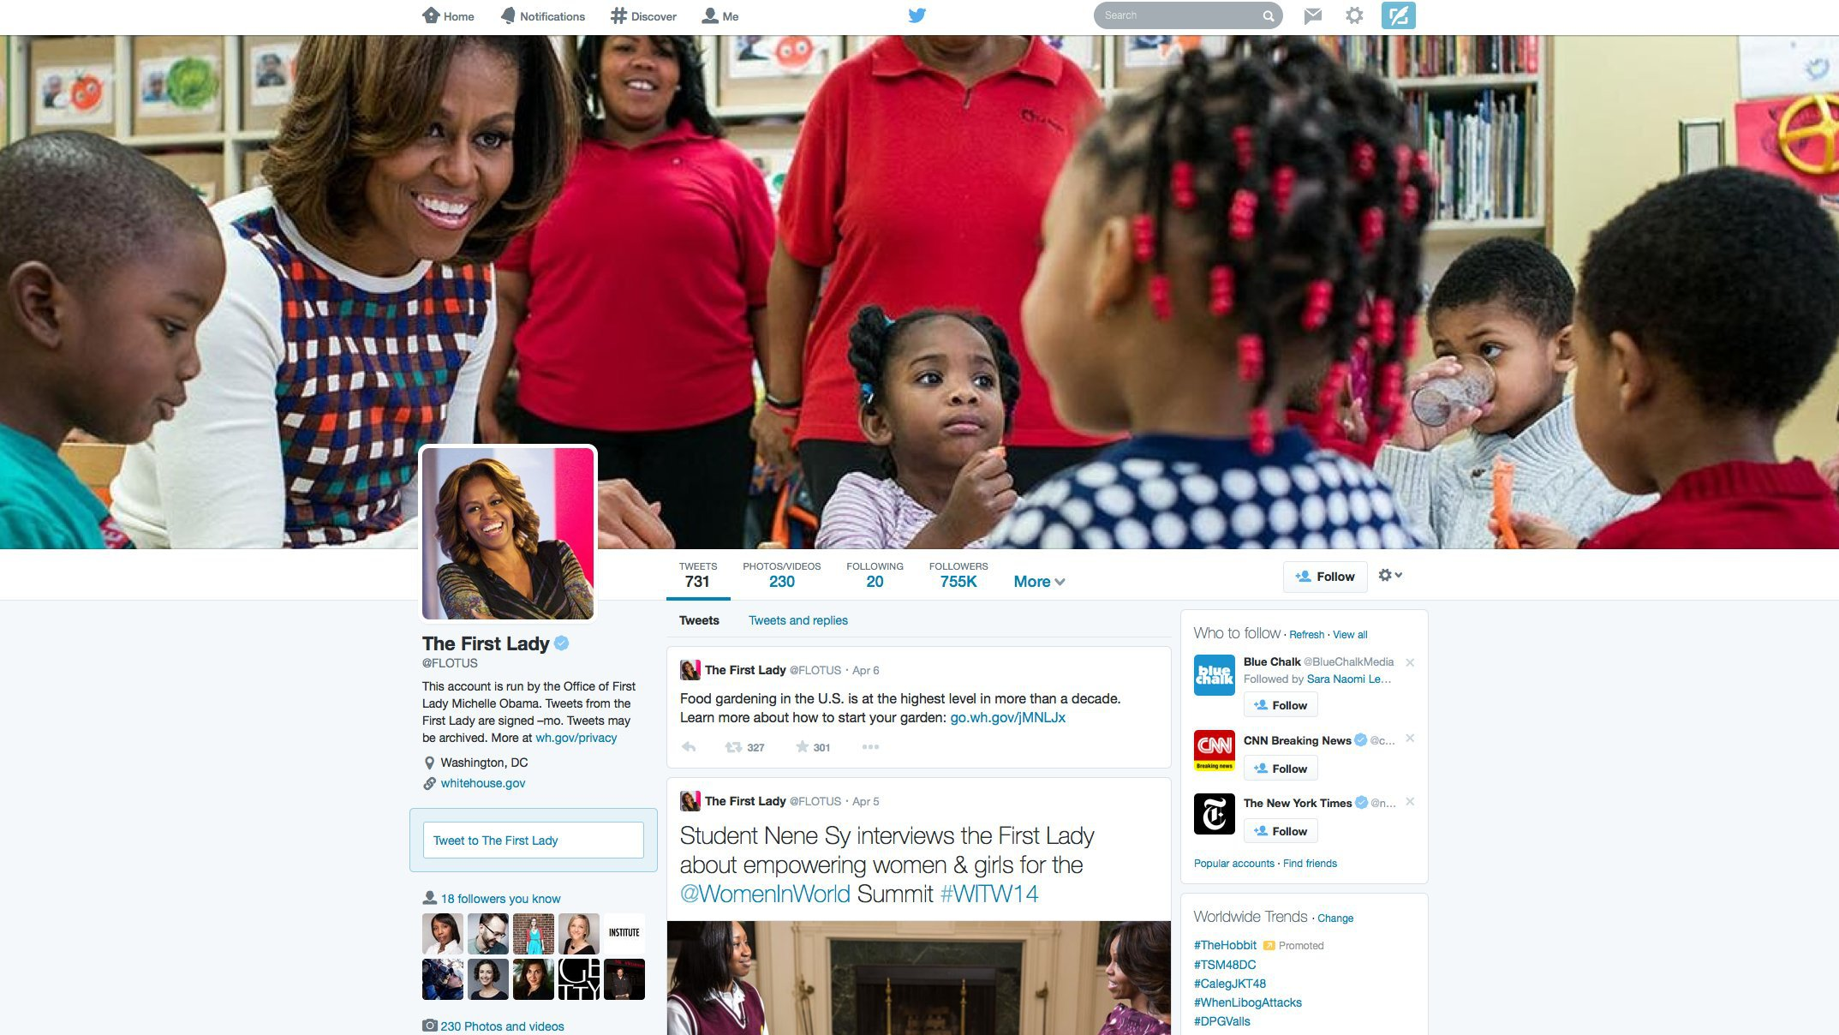
© 2022 The Regents of the University of Michigan
Notes:
Here is an example of First Lady Obama’s Twitter page.
It shows you how many followers she has and the people she is following.
You can also view her tweets and photos/videos.

Slide 7
Instagram
Online photo-sharing, video-sharing, and social-networking platform
Allows users to share pictures and 60-second videos publicly or privately
© 2022 The Regents of the University of Michigan
Notes:
A few years later, in 2010, Instagram was launched.
When it was first released, Instagram only allowed users to post photos online, however a video sharing feature was recently added.
The new feature now allows users to share 60-second videos.

Slide 8
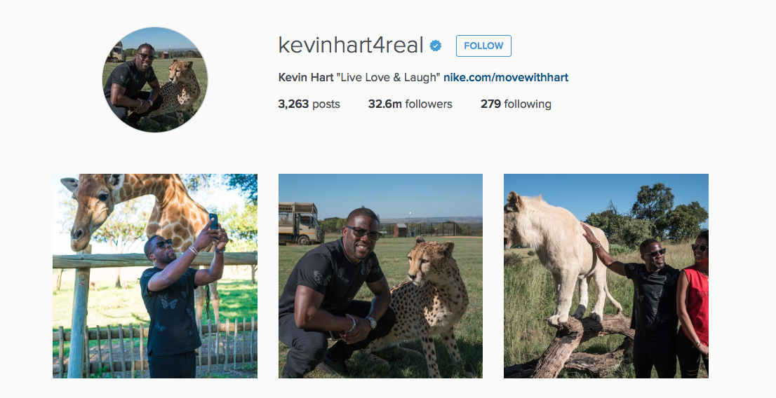
© 2022 The Regents of the University of Michigan
Notes:
Here is Kevin Hart’s Instagram page.
Similar to Twitter, it allows you to see his posts, followers, and who he is following.

Slide 9
SNAPCHAT
Messaging app with a set time limit for displaying photos and short videos
Snapchats DO NOT go away forever
© 2022 The Regents of the University of Michigan
Notes:
Snapchat is another popular private messaging app for photos and short videos only.³
Although it is advertised that the photos and videos are automatically deleted after they’ve been viewed for a few seconds, some phones and computers are even capable of taking screenshots of the photos or videos you share.
This means that even if people can no longer view your snapchat, they have a separate picture saved on their phone or computer.

Slide 10
© 2022 The Regents of the University of Michigan
Notes:
Here is an example of a snapchat profile and images. The icon in the top right corner of the pictures shows how much time someone has to view the picture or video you uploaded.

Slide 11
Youtube
Free video sharing website
Allows people to discover, watch, and share originally-created videos
© 2022 The Regents of the University of Michigan
Notes:
YouTube is a free video sharing website that allows people to watch and share originally-created videos.
“With so much content on YouTube, it's important to note that not all YouTube videos are appropriate for everyone, especially children under the age of 13. However, there are tools you can use, such as Safety Mode, to restrict the types of videos you can view.”⁴

Slide 12
Tumblr
Blogging platform dominated by pictures, videos, and animated graphics
© 2022 The Regents of the University of Michigan
Notes:
The final social media platform we are going to discuss is Tumblr. Tumblr is a blogging site used to share pictures, videos, and animated images. The site also allows you to post words and music or other sounds.

Slide 13
What do you do online?
© 2022 The Regents of the University of Michigan
Notes:
So, now that we’ve talked about some of the most popular networking sites that young people use we are going to discuss some of the ways people may behave online.

Slide 14
Risky
Behaviors
SENDING mean or rude messages
SHARING inappropriate photos
TALKING to people you don’t know
VISITING adult sites
© 2022 The Regents of the University of Michigan
Notes:
While there are a lot of ways to act positively online, sometimes people engage in risky behaviors such as:
Sending mean or rude messages
Sharing inappropriate photos
Talking to people they don’t know –and—
Visiting adult sites.⁵

Slide 15
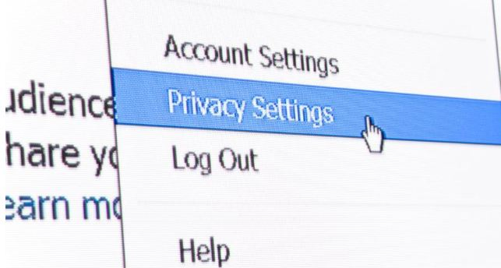
Too much information (TMI)
Passwords
Home Address
Location
Home/Cell Phone Numbers
© 2022 The Regents of the University of Michigan
Notes:
What type of information should you avoid posting on social media?
(CLICK SLIDE)

Slide 16
INAPPROPRIATE CONTENT
Drinking and drug use
Hate speech
Offensive gestures
Profanity
Revealing or suggestive images/pictures
Threats
© 2022 The Regents of the University of Michigan
Notes:
In addition to not putting personal information on social media, you should also avoid posting things related to drinking and drug use, hate speech, offensive gestures, profanity, revealing or suggesting images/pictures, and threats.⁵

Slide 17
Posting these things may…
Ruin your reputation
Get you in trouble with your parents, school, or the law
Damage future opportunities
© 2022 The Regents of the University of Michigan
Notes:
Posting inappropriate information can have negative consequences such as ruining your reputation, getting you in trouble with your parents, school or the law, and damaging future opportunities.

Slide 18
Friend or Fake
Place your screenshot here
© 2022 The Regents of the University of Michigan
Notes:
Now we’re going to watch a video about online behavior and things to consider when adding people as friends on social media sites.⁵
(PLAY VIDEO)
What are some of your reactions to the video? What should Keyan have done differently in the beginning?
(WAIT FOR ANSWERS)

Slide 19
is Internet safety important?
Why
© 2022 The Regents of the University of Michigan
Notes:
Keyan’s situation demonstrates how some people use social media to talk to people they may not know. Let’s consider why online safety is important. What are some reasons why people should be safe when using the internet?
(WAIT FOR ANSWERS)
You all mentioned some great answers. In summary, it’s important to be safe when using the internet and different forms of social media because certain behaviors can have negative consequences.

Slide 20
Place your screenshot here
Cyberbulling
© 2022 The Regents of the University of Michigan
Notes:
This second video provides an example of cyberbullying—which is a negative behavior we should avoid.⁵
(CLICK VIDEO)
What are your reactions to the video? What should you do if you or one of your friends is being cyberbullied?

Slide 21
Who might I hurt?
How could this impact my future?
Do I like what this says about me?
Ask
yourself
Would the adults in my life think
this is appropriate?
Could this get me into trouble?
© 2022 The Regents of the University of Michigan
Notes:
In order to avoid cyberbullying and other negative online behaviors, you can ask yourself the following questions before you post something:
(CLICK SLIDE)
Could this get me into trouble?
Do I like what this says about me?
Who might I hurt?
Could this impact my future?
Would the adults in my life think this is appropriate?⁵

Slide 22
Once You post something online, You Can’t take it back.
© 2022 The Regents of the University of Michigan
Notes:
One of the most important things to remember about posting messages or pictures online is that, once you post it you can’t take it back—even on apps like Snapchat.
Although we didn’t mention them here, these safety tips also apply to online game chat rooms and even text messages.

Slide 23
“Practice Safe Online Habits”
© 2022 The Regents of the University of Michigan
Notes:
A final reminder is to practice safe online habits in order to avoid negative consequences!

Slide 24
References
What is Facebook? http://www.gcflearnfree.org/facebook101/what-is-facebook/1/
What is Twitter? https://support.twitter.com/articles/215585
Moreau, E. (2016). 10 of the Hottest Social App Trends for Teens. Lifewire. Retrieved from https://www.lifewire.com/hottest-social-app-trends-for-teens-3485940
What is YouTube? http://www.gcflearnfree.org/youtube/what-is-youtube/1/
NetSmartz Workshop (2015). Internet Safety-Teens/Tweens. Retrieved from http://www.netsmartz.org/Presentations/Teens, http://cdn.netsmartz.org/presentersguides/NetSmartz_Teens_Presenters_Guide_2015.pdf, http://cdn.netsmartz.org/presentersguides/NetSmartz_Tweens_Presenters_Guide_2015.pdf
© 2022 The Regents of the University of Michigan

Slide 25
Image Sources
Facebook: https://facebookbrand.com/wp-content/themes/fb-branding/prj-fb-branding/assets/images/fb-art.png
https://fortunedotcom.files.wordpress.com/2015/11/screen-shot-2015-11-09-at-1-35-48-pm-copy.jpg
Twitter: http://goinkscape.com/wp-content/uploads/2015/07/twitter-logo-final.png
https://localtvwjw.files.wordpress.com/2014/04/obama.jpg?quality=85&strip=all
Instagram: http://3835642c2693476aa717-d4b78efce91b9730bcca725cf9bb0b37.r51.cf1.rackcdn.com/Instagram_App_Large_May2016_200.png
https://cmgajcbuzz.files.wordpress.com/2016/03/kh.png
Snapchat: http://data.whicdn.com/images/237677174/large.png
http://hothardware.com/ContentImages/NewsItem/36395/content/Snapchat_Profile.jpg
https://usatftw.files.wordpress.com/2016/11/union-wade.jpg?w=1000
YouTube: https://www.youtube.com/yt/brand/media/image/YouTube-logo-full_color.png
Tumblr: https://d1sui4xqepm0ps.cloudfront.net/categories/tumblr?image=cdn
http://www.potentash.com/wp-content/uploads/2015/09/black-children-online.jpg
https://dailyprivacy.files.wordpress.com/2013/02/blog21.jpg
http://www.digitalmomblog.com/wp-content/uploads/2010/06/internet-safety-month.jpg
http://www.theblackhomeschool.com/wp-content/uploads/2014/12/download23.jpg
Friend or Fake: https://www.youtube.com/watch?v=y4nyluaXoFY
http://media.istockphoto.com/photos/thinking-daydreaming-young-man-looking-away-picture-id184383834?s=235x235
Cyberbullying: https://www.youtube.com/watch?v=xGKmlTtZnSk
http://www.clipartkid.com/images/728/boy-thinking-clipart-cliparts-co-oO2xys-clipart.gif
http://www.todaysparent.com/wp-content/uploads/2013/09/TP10_LittleBodies411.jpg
© 2022 The Regents of the University of Michigan

Slide 26
Credits
Special thanks to all the people who made and released these awesome resources for free:
Presentation template by SlidesCarnival
Photographs by Startupstockphotos
© 2022 The Regents of the University of Michigan

